Slide 1
Greece: a gateway for gas in SE Europe
Power & Gas Supply Forum| 31.03.2022

Slide 2
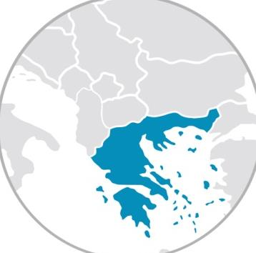
DESFA implements its ambitious investment plan to strengthen Greece role as an energy hub in South East Europe; all new pipelines H₂ ready
DESFA’s 10YDP - €800 M within the next 5-year period
HP Pipeline to
Western Macedonia
Investment: €147 M
Developer : DESFA
1
FSRU Alexandroupolis:
Shareholders: Gastrade (DESFA 20% stake)
Under construction
Participations
6
6
1
6
Bulgaria
HEnEx
(Hellenic Energy Exchange)
Shareholders: DESFA 7%
HP Pipeline to
Western Greece
Investment: €98 Μ
Developer: DESFA
2
Bulgaria
7
7
7
7
8
2
Greece - Bulgaria
Interconnector (IGB)
North
Macedonia
Greece - Bulgaria
Interconnector (ICGB)
N. Macedonia
Sidirokastro
3
3
Sidirokastro
Greece - N. Macedonia
Interconnector
Greece - North Macedonia
Interconnector
Interconnector
Greece – Bulgaria (IGB):
Shareholders: DEPA, Edison, BEH
Other developers
Nea Messimvria (TAP entry)
11
Kipoi
8
Interconnector
Greece – North Macedonia
Investment: €67 M
Developer : DESFA
Albania
Nea Messimvria (TAP)
0
6
Kipoi
3
Albania
8
9
UGS
South Kavala
3
1
UGS
South Kavala
Italy
Pipeline to
West Macedonia
Italy
6
TAP
Pipeline to
West Macedonia
FSRU
Alexandroupolis
Italy
8
W. Macedonia
FSRU
Alexandroupolis
Italy
W. Macedonia
Natural Gas to
Ioannina
Trans Adriatic Pipeline (TAP) Shareholders: BP, Socar, Snam, Fluxys, Enagás, Axpo
1
9
5
8
SSLNG & Truck Loading Station
SSLNG Jetty: €22.5 M
Truck Loading: €7.5 M
Developer : DESFA
4
4
7
HEnEx
Pipeline to
Western Greece
FSRU Dioryga Gas
Shareholders: Motor Oil
5
10
SSLNG & TLS
4
2
4
Revithoussa
LNG Terminal
2
10
W. Greece
FSRU Dioryga Gas
W. Greece
4
2
4
2
Pipeline to
Western Greece
Revithoussa
LNG Terminal
Natural Gas to
Ioannina
Developer: DESFA
5
Agia Triada (LNG)
UGS South Kavala
Expression of interest to develop the infrastructure
Tender
5
Agia Triada (LNG)
11
Existing lines
Projected lines
Entry points
2

Slide 3
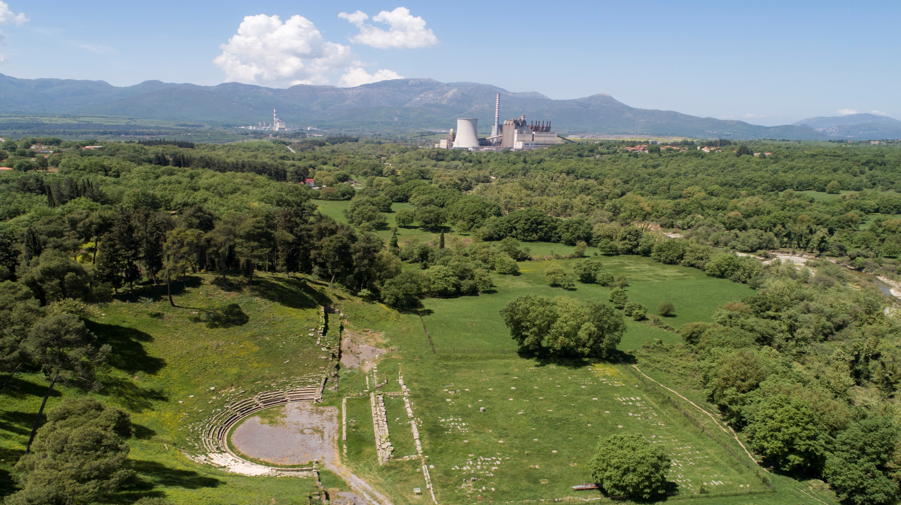
DESFA’s Ten-Year Development Plan 2022-2031
74 projects of high added value
€830 million total budget
Large scale investments which confirm the key role of natural gas infrastructure
in the energy transition, contributing to the implementation of the National Plan for Energy and Climate & the Just Transition Development Plan of lignite areas

Slide 4
New market dynamics (South to North, Eastern branch, TAP) require upgrade of the NGTS
Market participation is a key; UGS Kavala may be the pivot for the upgrade
Max. flow:
< 8.16 mn Nm3
IGB
Sidirokastro:
10.3 mn Νm3/d
2
Komotini
Kipi
Compression
Station
Karperi
D=36”
D=24”
D=24”
D=36”
Kipi:
4.3 mn Νm3/d
D=36”
Kavala Compressor station
5
1
Nea Messimvria
Compression
Station
South Kavala UGS
Working Gas = 530 mn m3 (or 6.360 GWh)
Max Withdrawal = 9 mn m3/d
Max Injection = 7 mn m3/d
FSRU
Gastrade
TAP: 4.6 mn Νm3/d
Max. flow:
< 15.1 mn Nm3/d until 2023
< 19.9 mn Nm3/d after 2023
D=30”
3
Investments
4
Ampelia Compressor Station
1
New CS at the eastern branch and CS at Komotini
D=30”
2
Duplication of the East HP branch (Karperi – Komotini)
Patima
Upgrade of the existing Compression station at Nea Messimvria and the planned at Ampelia
3
FSRU
Dioriga Gas
D=30”
4
Duplication of the HP branch Nea Messimvria – Patima branch
5
Duplication of the HP branch Karperi - Drymos
Revithoussa
LNG Terminal
19.15 mn Νm3/d

Slide 5
m.thomadakis@desfa.gr

